Slide 1

Welcome to the Vue JS Tutorial

Slide 2

“
How to get help?
“
Udemy Q&A

Slide 3
Vue JS

Slide 4
What is Vue JS?
Vue JS is a popular JS framework for building UI’s.
Vue does not focus other aspects like routing, HTTP Request or state management.
Vue JS has a rich ecosystem that have libraries like Vuex, Vue Router, Vuetify and so on…

Slide 5
Vue Libraries
Vuex
State Management
Vue Router
Routing
Vuetify
UI Elements

Slide 6
Why Vue JS?
195 k GitHub stars and 5th in the world.
Developers really like working with Vue JS.
It helps find solutions to most of the problems developers face.

Slide 7
Why Vue JS?
Vue is approachable.
Vue is versatile.
Vue is performant.
Vue is a framework built by taking the good parts from other frameworks and then improving where necessary.
…and Action!

Slide 8
Requirements
HTML, CSS and JS fundamentals.
ES2015+ features and modern JS knowledge

Slide 9
First Vue App
Preview

Slide 10


App Review
Title
Input:
Output:

Slide 11


“QWERTY”
“1234”
“QWERTY”

Slide 12
Code Editor
Setup

Slide 13
App Review
Title
Input:
Output:

Slide 14
https://bit.ly/3tlNr7C

Slide 15
Vue Template
&
Vue Instance

Slide 16
App Review
Title
Input:
Output:

Slide 17
App Review
Title
Text and form input
When user type something image needs to rendered on the screen
Input:
Output:

Slide 18
Vue Libraries
Vue Template
Created in HTML
Vue Instance
Created in JavaScript

Slide 19
Building
Vue Template

Slide 20
Vue Libraries
Vue Template
Created in HTML
Vue Instance
Created in JavaScript

Slide 21
Creating
Vue Instance
And
Binding to Template

Slide 22
Vue Libraries
Vue Template
Created in HTML
Vue Instance
Created in JavaScript

Slide 23
HTML World
JavaScript
World
<div id=“root”>
Vue Instance
Vue Template
‘el’ property

Slide 24
Flow Chart
Detect input
Get the text
Generate a Pic
Show the Pic
Title
Input:
Output:

Slide 25
Imperative Programming
Declarative Programming
vs.
Explicit Instructions
The system is dull you are smart
Describe the Outcome
The system is smart, you don't care

Slide 26
Imperative
Follow Recipe Step by Step
Step 1
Step 2
Step 3
…
🎂

Slide 27
Declerative
Ingredients
Rule 1
Rule 2
Rules
Initial State
…
🎂

Slide 28
Declerative Programming
If text entered, update ‘inputContent’
If template is rendered, generate an image
inputContent = “QWERTY”
If inputContent is updated, rerender the template
App

Slide 29
Declerative Programming
If text entered, update ‘inputContent’
If template is rendered, generate an image
inputContent = “”
If inputContent is updated, rerender the template
App
data
methods
computed

Slide 30
Declerative Programming
If text entered, update ‘inputContent’
If template is rendered, generate an image
inputContent = “QWERTY”
If inputContent is updated, rerender the template
App
data
methods
computed

Slide 31
Vue API
data
The initial state of Vue Instance
methods
The different ways that state can change
computed
How to turn the current data into viewable values

Slide 32
Challanges
Need to somehow search for videos on Youtube
Need to show some different elements on the screen
Need to place to write code and run it
Solutions
Sign up for Youtube API use it search for videos
Use Vue to create a couple of components
Use Vue CLI tool to generate new project file directory
Need to handle user input, like typing in the search term and clicking on videos
Use same Vue directives, methods and computed functions

Slide 33
Generating a New Vue Project

Slide 34
HTML World
JavaScript
World
<div id=“root”>
Vue Instance
Vue Template
‘el’ property

Slide 35
Vue Files
HTML
CSS
JavaScript

Slide 36
Vue Instance
Vue Component
An instance of a Vue Component
Represent a set of rules for getting content on the screen and how users can interact with

Slide 37
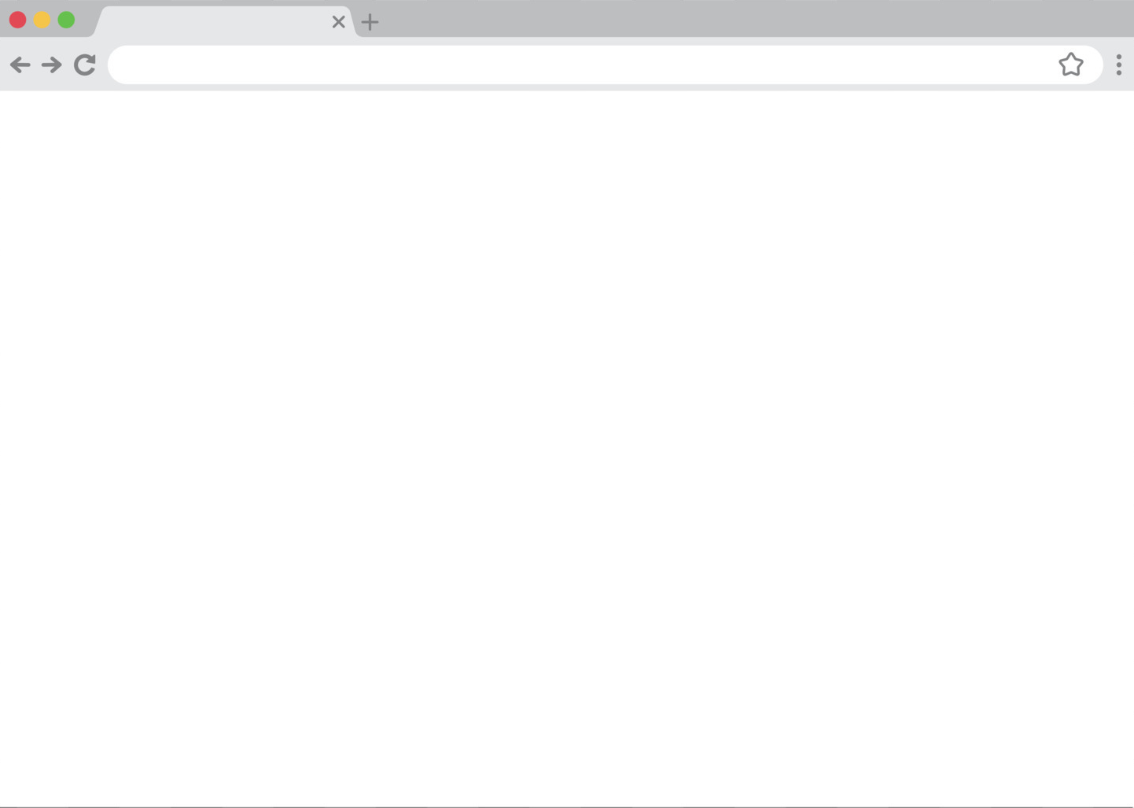


App
sky
SearchInput
Details
ShowMedia
Videos
Item

Slide 38
Main.js
App
SearchInput
ShowMedia
Videos
VideoItem
VideoItem
VideoItem

Slide 39
Parent
Child
Child
Child
UP
Easy to pass data
DOWN
Sibling
to
Sibling
Passing data can be Challenging

Slide 40
App
ShowMedia
SeachInput
Videos
UP
UP
EMITTING
EVENTS
PROPS
DOWN
DOWN

Slide 41

Pixabay API
Request
input
Response
Client
Server

